Slide 1
Advising Through transition: Divorce
Practice Development Series

Slide 2
The cause and Effect of Transitional Life Events
Understanding Grief
Life Event
causes
Personal loss
triggers
Emotional and physical responses
creates
Financial behaviors and impact
Notes:
Let’s quickly review the effect of life transitions on financial planning:
Something happens in life. Death, Divorce, Illness, etc.
It causes a feeling of personal loss. There are lots of kinds of losses: Material, emotional, intrapsychic, spiritual, etc.
The loss triggers physical and emotional responses (irrational behavior, spontaneous decisions, etc.)
These responses have real world impact on people’s financial lives.
What’s the impact on your business?

Slide 3
70%
The Big picture
of new investments and referrals come during times of client transition.
12%
of AUM value of your practice is at risk to the Big 3 client transitional events in any given year: Death, Divorce, Disability.
Source: https://www.onefpa.org/journal/Pages/MAR17-3-Communication-Skills-for-Working-with-Grieving-Clients-.aspx, accessed 09/24/2018
Notes:
Because money in motion is triggered by transition, as much as 12% of your AUM on an annual basis are at risk because of JUST the three biggest events:
Death
Divorce
Illness.
Today we’re going to focus on divorce.

Slide 4
Marriage is about Love.
Divorce is about Money.
Notes:
there’s an old saying that is universally true. Everything is great and copacetic until it’s not. Then it’s all about the money.

Slide 5
American divorce
The statistics
Lifelong probability of divorce is 40-50%
2nd Marriage divorce rate = 67%
3rd Marriage divorce rate = 75%
AVERAGE cost of divorce = $15,000. Substantially higher the older the couple.
Notes:
Divorce generally is on a slight decline from where it was 30 or 40 years ago, but still, the lifelong probability is somewhere between 40-50%.
The odds get substantially worse for 2nd and 3rd timers.
The AVERAGE cost of divorce is about $15,000. But that’s a deceptive number. It takes into account all age ranges, so 19-20 year olds as well as 70-80 year olds. Younger people have less complications, thus cost is lower. The older you are, the more complicated the household situation, the more it costs. Ask the talk show host Larry King how much each of his 8 divorces have cost him.

Slide 6
Grey Divorce
The statistics
2-3x increase since 1990
Worse for women than men.
Healthcare is a major concern.
Understand individual expenses and balance sheets.
Notes:
One of the alarming statistics surrounding divorce is the emergence of so-called “Grey Divorce”. While most age groups in America have experienced a decline in divorce rates over the past several decades, divorce for your older clients is on the rise. For clients age 50 and older, the rate has doubled since 1990. And for those age 65 and older, it has tripled. This should be particularly concerning to the financial advisor for three main reasons:
Look at the composition of your book and the deployment of your assets. Most of your assets under management reside with people 50 and older. This puts a greater risk on those assets over time.
Perhaps more importantly, the financial rending of accounts at this age is more damaging than when people divorce at age 20 or 30, when their assets, responsibilities and obligations are comparatively smaller. Just as when clients face a financial loss later in life, it is more difficult for them to recover because of lost time and a shorter time horizon, similarly, the financial impact at later age of divorce is more difficult to overcome.
Furthermore, divorce at this age can be devastating for women. Women see a 45% decrease in standard of living vs only 21% for men. Given the demographics of people at in their 50’s and 60’s, it’s likely that the work prospects for your later-divorced women are not sufficient for them to avoid slipping toward poverty. Typically the male gets retirement accounts and the female gets the house. What looks equitable at first is many times not so fair. Why? Retirement assets tend to grow over time, whereas the house is saddled with maintenance and taxes and must be liquidated in order to provide retirement income.
So what are some steps we can take to work with our clients to help them improve their outcomes? (next slide)
https://www.usatoday.com/story/opinion/voices/2018/09/06/gray-divorce-elderly-couples-marriage-column/1183820002/
https://www.investmentnews.com/article/20160112/BLOG05/160119983/gray-divorce-boosts-poverty-level-for-women
Barron’s, “Divorce is Costly. Divorce in Retirement is Costly and Complicated”, September 29, 2019.

Slide 7
Know the rules
Divorce
State
Broker/dealer
Professional designation
Your personal sense of morals/ethics.
7
Notes:
The rules governing how you can work with your divorcing clients are laid out by by several authorities:
State
Broker/dealer
Professional designation
Your personal sense of morals/ethics.
As I mentioned earlier, divorce can be particularly tricky if you have a relationship with both parties. The laws surrounding divorce and more particularly, your role as a financial professional will vary. So the first thing you should do is make sure you understand the rules that govern your state. Next, be sure you are following any of your firm’s specific rules and guidelines.
Also, note that the CFP Board’s Code of Ethics and Financial Responsibility and its Rules of Conduct don’t explicitly prohibit working with both parties during a divorce, but there is an obligation on the part of an advisor to communicate any potential conflicts to both of their clients and to their compliance department after becoming aware of a divorce.
DO NOT READ -
“Conflicts of Interest Between CFP® Professionals and Clients” | https://www.cfp.net/docs/for-cfp-pros---professional-standards
enforcement/cfpboard_advisoryopinion_conflicts_of_interest.pdf?sfvrsn=4

Slide 8
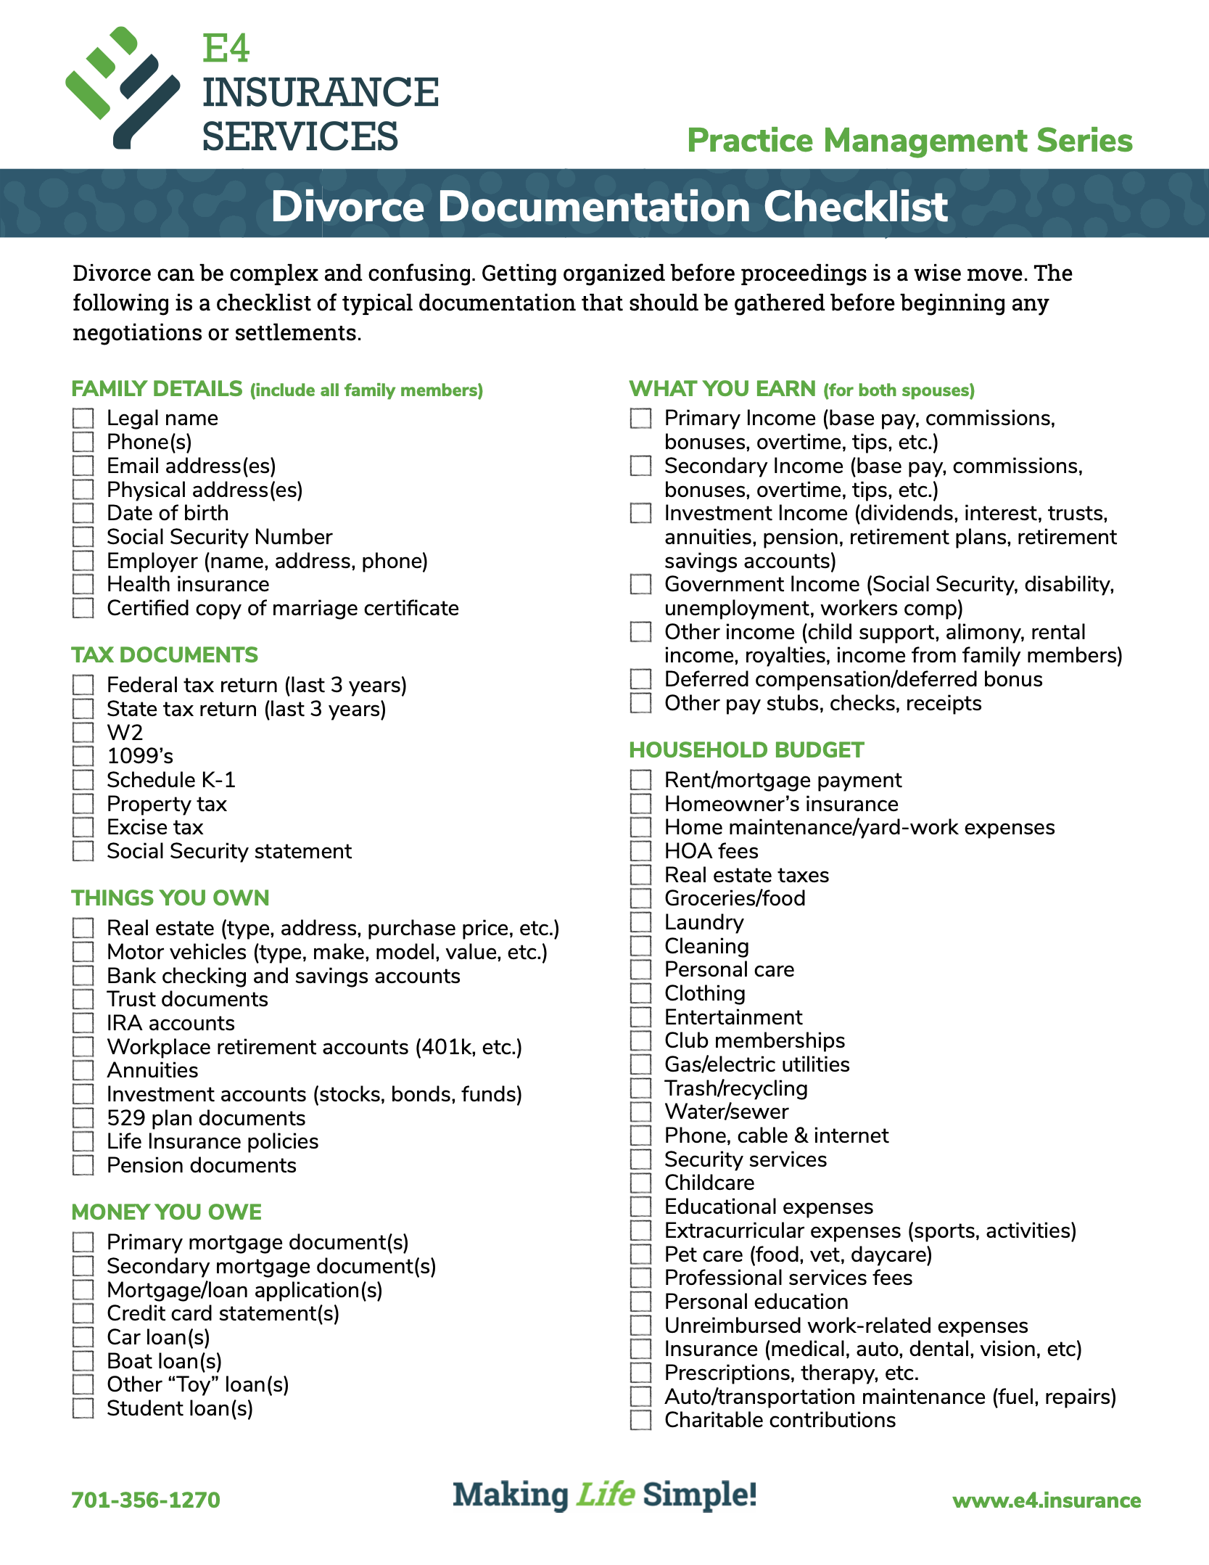
Perfect Practice
Understand your role
LISTEN
Listen, listen, and then listen more.
Remain objective. Never take sides.
COMMUNICATE
Help organize information
Simultaneous transparent communication to both parties.
Set advice/service expectations.
Deliver complete financial packets to both parties.
REFER to other professionals.
Notes:
So what is your role as a financial professional when working through divorce situtations? It can best summarized by three words: LISTEN
COMMUNICATE
REFER
Understand your limitations where it comes to knowing how you can and can’t help in these situations.

Slide 9
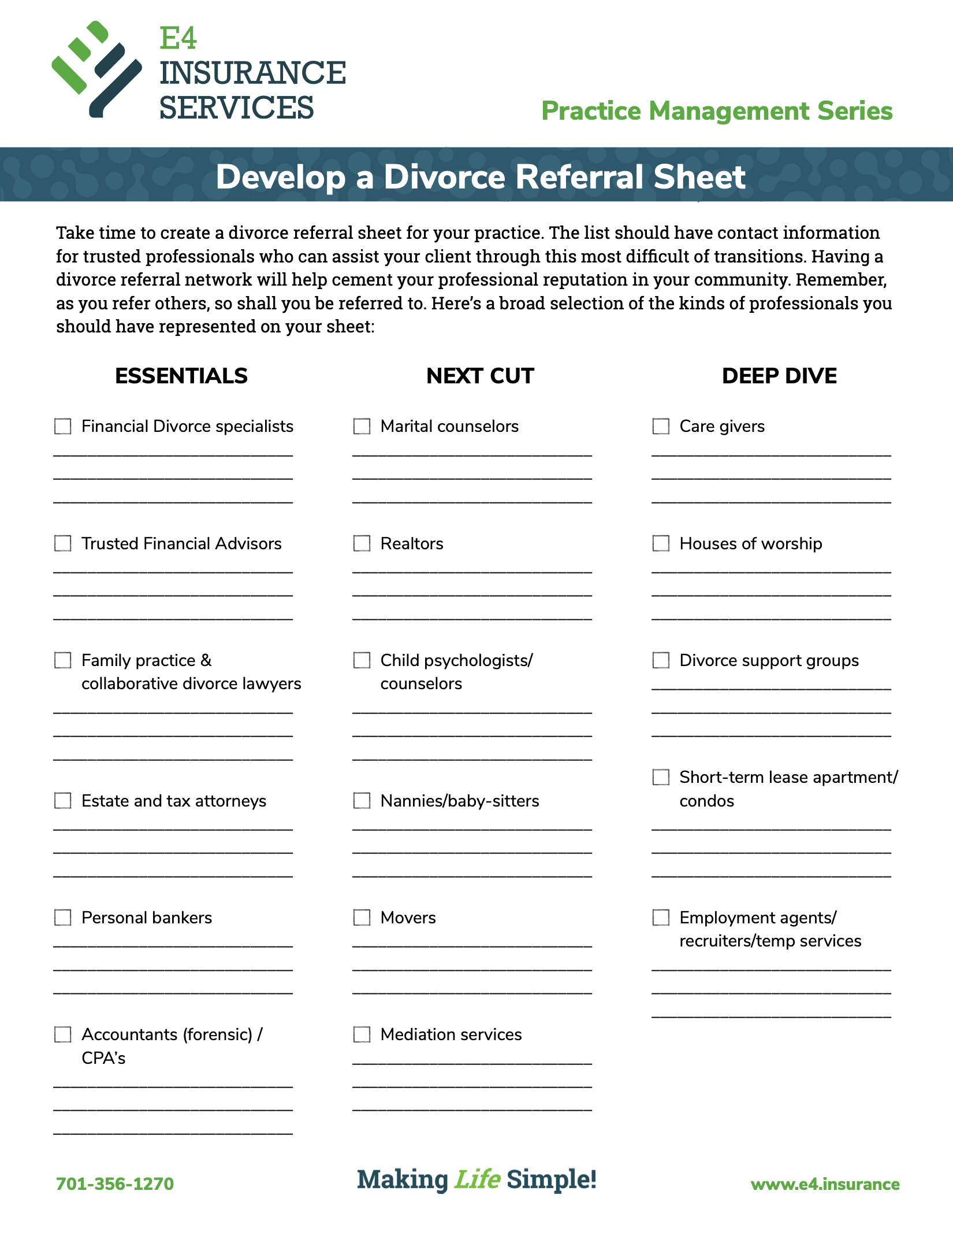
Divorce Referral Sheet
Understand your role and limitations.
As you refer out, so shall you be referred to.
Use our template on your letterhead.
Notes:
The last bullet on the previous slide talked about REFER. One of the best ways you can help a divorcing couple is by being a source for other professionals. We’ve developed a referral template as a handout for this presentation that you can use to create a list of your trusted resources in each of a number of different specialties. Prepare this list with names, phones, and e-mail addresses and make it one of the first things you give to your client when you discover that they’re going through this.

Slide 10
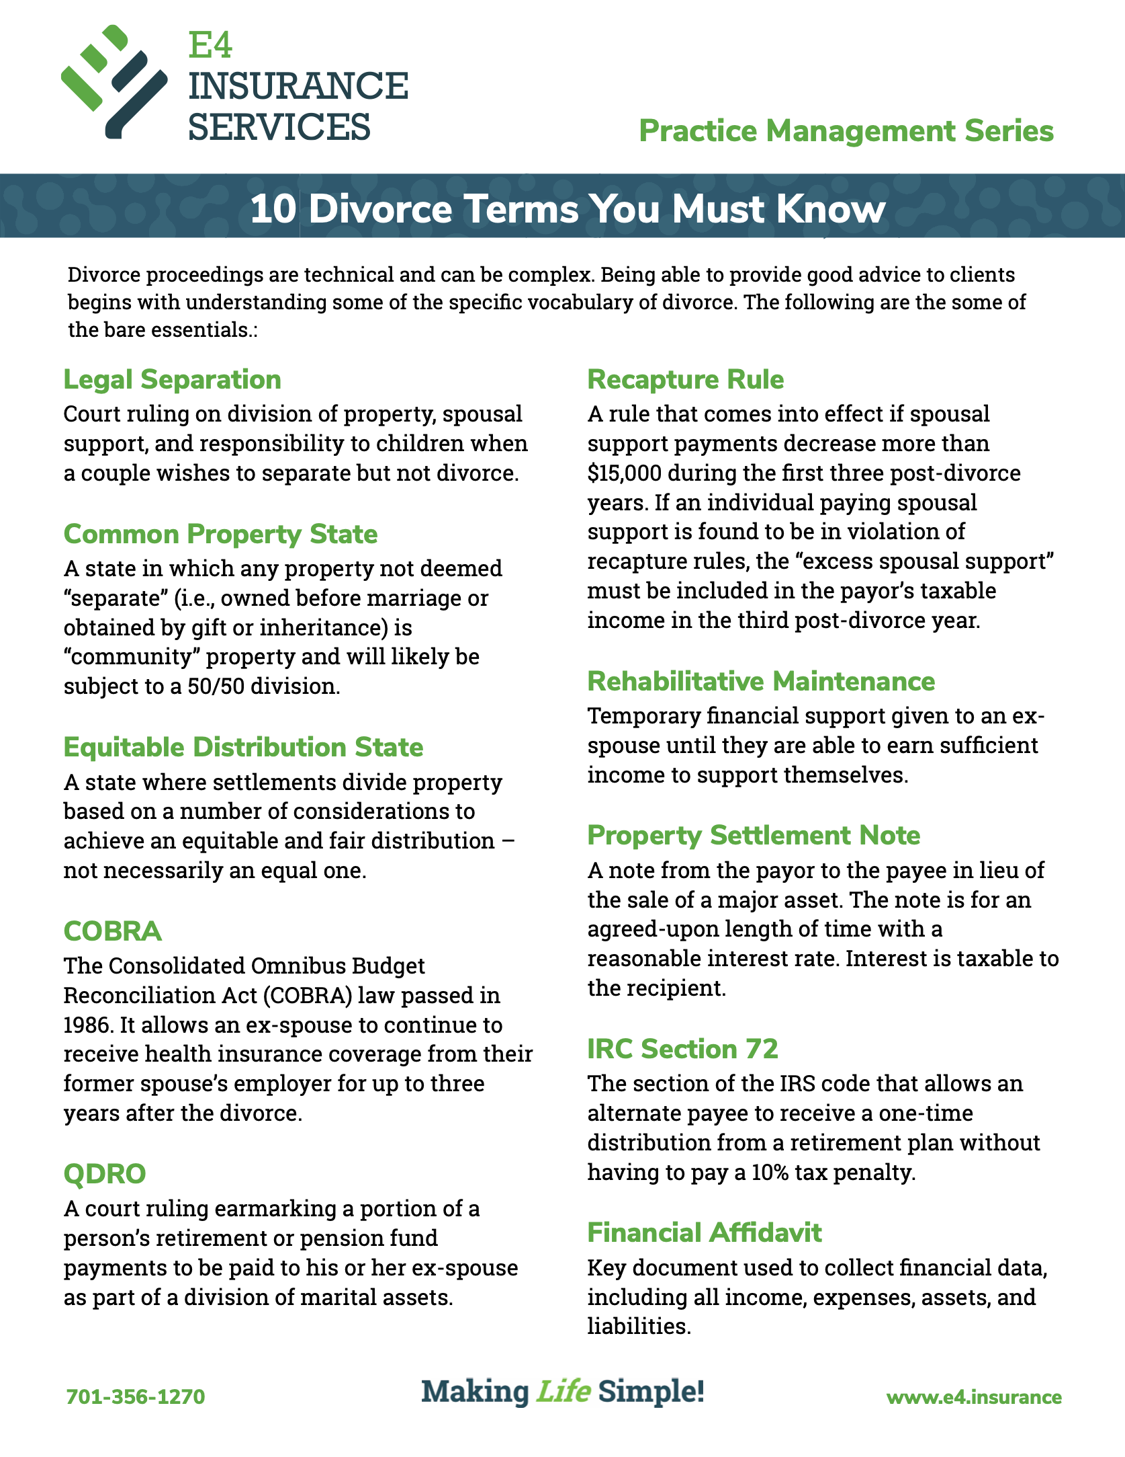
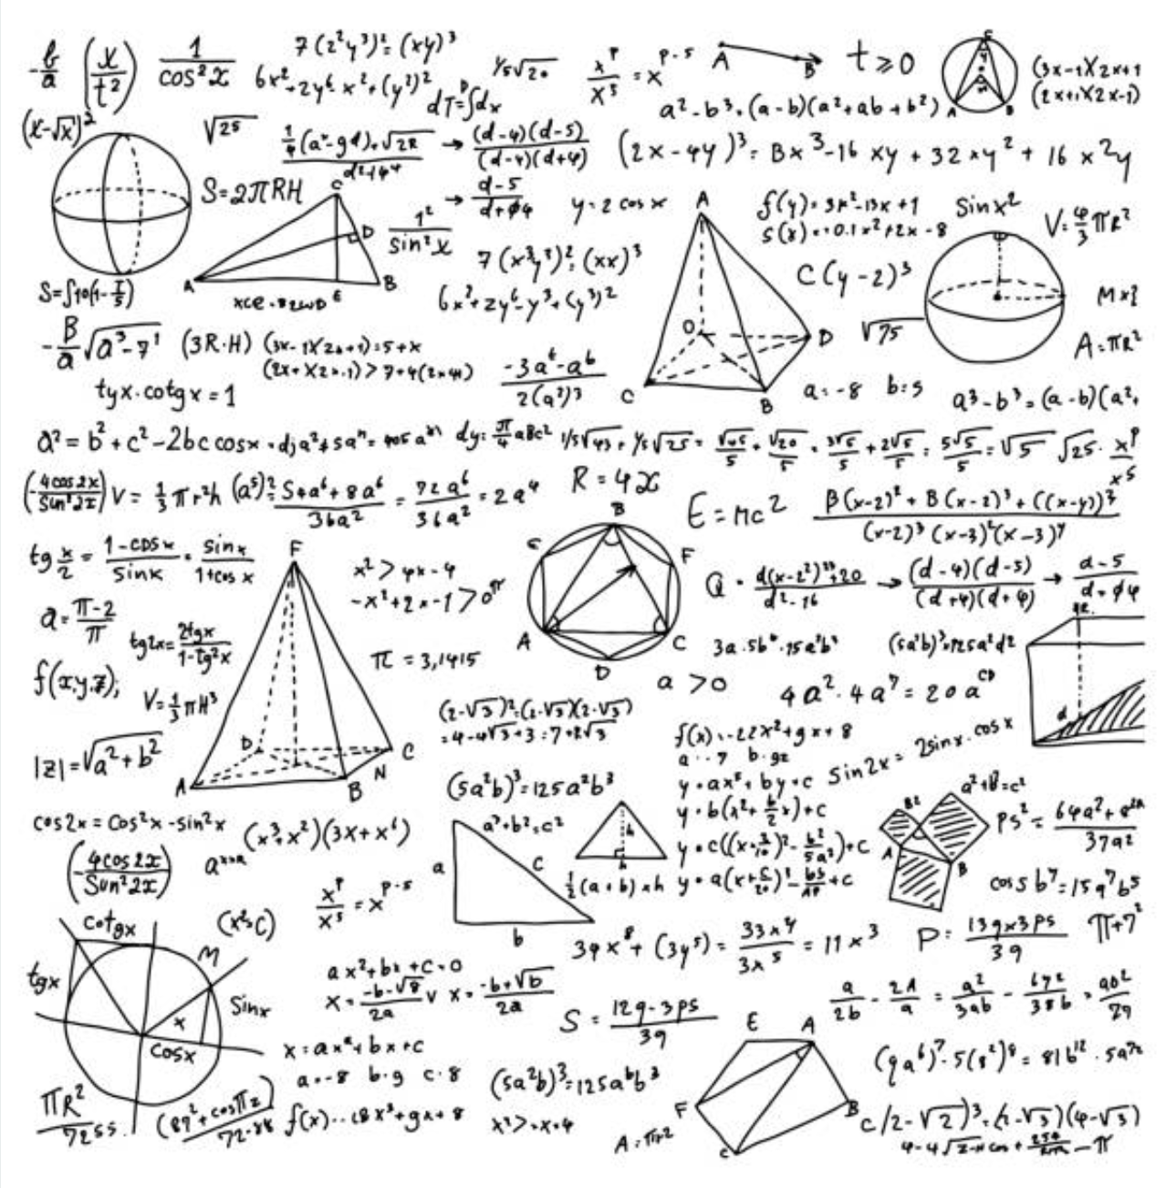
10 Key Divorce Terms Every advisor should know:
Divorce
QDRO
Financial Affidavit
COBRA
Common Property State
Equitable Distribution State
Legal Separation
Recapture Rule
Rehabilitative Maintenance
Property Settlement Note
IRC Section 72
Notes:
While no one expects that as a financial advisor you are also an expert at divorce, there are several terms and concepts that you should make sure you’re familiar with.
Look through this list. Could you explain what each of these 10 items is? If not, you probably need to at least get familiar with them.
We’ve prepared a handout with each of these terms and their associated definitions.
1. QDRO
A court ruling earmarking a portion of a person’s retirement or pension fund payments to be paid to his or her ex-spouse as part of a division of marital assets.
A Qualified Domestic Relations Order (QDRO) is an order from the court that says how an employee’s retirement plan should be divided up between the employee and his or her ex-spouse. The QDRO should include how much to allocate to each spouse, when the non-employee spouse can start receiving benefits, and what happens when either party dies. The details of retirement plans can be incredibly tricky, so it’s important to have an attorney or experienced professional draft the QDRO.
2. Financial Affidavit
Key document used to collect financial data, including all income, expenses, assets, and liabilities.
The financial affidavit is the backbone of any divorce settlement. Full disclosure and accuracy are imperative, but it is also important to note that the affidavit changes frequently as new information comes to light. This document may sound straightforward, but it can be surprising how many people are not involved in family finances and are ill-prepared to compile the necessary information.
3. COBRA
The Consolidated Omnibus Budget Reconciliation Act (COBRA) law passed in 1986. It allows an ex-spouse to continue to receive health insurance coverage from his or her former spouse’s employer for up to three years after the divorce.
This federal law is a nice safety net for divorcing individuals who are on their ex-spouse’s insurance plan. However, premiums for COBRA coverage are often higher than when they were covered under the employer’s plan. Particularly with subsidies available under the Affordable Care Act, you should be sure to shop around to make sure you’re getting the best option.
4. Community Property State
A state in which any property not deemed “separate” (i.e., owned before marriage or obtained by gift or inheritance) is “community” property and will likely be subject to a 50/50 division.
The way that assets are divided in divorce depends on the property division statutes of the state. There are currently eight states that have community property statutes: Arizona, California, Idaho, Louisiana, Nevada, New Mexico, Texas, and Washington.
5. Equitable Distribution State
A state where settlements divide property based on a number of considerations to achieve an equitable and fair distribution – not necessarily an equal one.
The remaining 42 states (those that are not community property states) have equitable distribution statutes. In these states, property is divided based on many factors, including the length of the marriage and differences in age, wealth, earning potential, and health of the partners involved. This forgoes the idea that settlements should always be 50/50 and attempts to create a fair post-divorce situation.
6. Legal Separation
Court ruling on division of property, spousal support, and responsibility to children when a couple wishes to separate but not divorce.
Couples may want pursue a legal separation rather than a divorce for several reasons, including religious principals, medical or insurance issues, or simply not wishing to be divorced. The state of Texas is the only state not to recognize legal separations.
7. Recapture Rule
A rule that comes into effect if spousal support payments decrease more than $15,000 during the first three post-divorce years. If an individual paying spousal support is found to be in violation of recapture rules, the “excess spousal support” must be included in the payor’s taxable income in the third post-divorce year.
One of the more confusing and easy-to-forget rules related to divorce, recapture can be a huge tax problem for individuals paying spousal support. The Tax Reform Act of 1984 created this rule to prevent a property settlement payment (which is fully taxable for the payor) from being disguised as spousal support (which is tax-deductible for the payor).
8. Rehabilitative Maintenance
Temporary financial support given to an ex-spouse until they are able to earn sufficient income to support themselves.
Rehabilitative maintenance became popular as a way to give ex-spouses a transition period. It is unrealistic to expect a lower wage-earning or stay-at-home spouse to immediately be able to earn enough income to support an entire household. Rehabilitative maintenance gives these individuals a chance to return to school or the workforce and transition into breadwinner status.
9. Property Settlement Note
A note from the payor to the payee for an agreed-upon length of time with a reasonable interest rate.
These notes are a tool in dividing property between spouses. If one spouse wishes to keep an asset that tips the scales in his or her favor (such as the marital home), a property settlement note can be drawn up to achieve an equitable settlement.
10. IRC Section 72
The section of the IRS code that allows an alternate payee to receive a one-time distribution from a retirement plan without having to pay a 10% tax penalty.
This little-known piece of the tax code can provide a great source of relief for individuals who received some part of their ex-spouse’s retirement plan in the divorce settlement. This one-time, penalty-free early distribution can help in establishing a post-divorce life, whether that’s buying a new car, renting a new apartment, or paying to go back to school. It should be noted that ordinary income tax does apply to this distribution.

Slide 11
Should you specialize?
Divorce
CDFA - Certified Divorce Financial Analyst.
Institute for Divorce Financial Analysts
www.institutedfa.com
CDS - Certified Divorce Specialist
National Association of Divorce Professionals
www.thenadp.com
Notes:
The last slide probably has you thinking that there’s a lot to know about divorce, and there is. If you want to make yourself stand out in the crowd of financial professionals, you may want to look into earning a Divorce designation. There are two generally recognized designations. The more rigorous of them is the CDFA. However, even obtaining a CDS, will give you some of the tools you need to be successful in working with your clients through these difficult times.

Slide 12
Avoiding Awkward
DIVORCE
What NOT to say… | Why not… | Instead, say…
I'm so sorry. | You have nothing to apologize for. Don't pity. Be sincere | It makes me sad to hear that.
Anything about failure. | Personal connotations of failure are difficult during grief. | Anybody that’s gone through it knows that marriage is one of the biggest challenges we face…
So, how are you? | It's tricky. Can be good but may make them uncomfortable. How are they supposed to be? | How do you feel about it today?
Well, it's good that's over with! | Um, no, it's not good. Divorce is traumatic. | Nothing
If you two can't make it work, who can? | Marriages have complicated dynamics. No two are alike. Why make assumptions? | Nothing
Did you try counseling? | If they didn't, they'll think you’re judging them as inept or irresponsible. | How can I support you right now?
S/he wasn't your type anyway. | They're already questioning their own ability to make decisions. Don't heap scorn. | Nothing
How are the kids? | The kids are upset. Duh. | Do any of the children need a listening ear?
So which one of you is moving? | Insensitive | How's the process going so far?
You're strong; you'll be fine; just move on. | It's human to want to help someone out of pain, but now is not the time. | I'm here to listen if there's anything you want to talk about…
“By the way, Bill and I are getting a divorce.”
Notes:
If you’re at all like me, you’re sometimes caught flat-footed when confronted with potentially awkward conversations that happen after your client says “Oh by the way, Bill and I are getting a divorce.” My knee-jerk reaction is almost always “I’m so sorry!”
Here are some common reactions and ways we can diffuse a bomb by changing how we respond.
We will forward attendees to this session a Compassionate Communication desktop reference by Amy Florian courtesy of our partners at Symetra.

Slide 13
What can insurance do for your clients going through divorce?
Practice management Series
LIfe Insurance
Annuities
LTC
May be mandated by court.
Provide supplemental income.
Provide liquidity
Help cover cost of care
Provide supplemental lifetime income
Fund a Property Settlement Note
Guarantee alimony, child-support, etc.
Protects an asset against financial loss
Help cover cost of care
Help prevent forced impoverishment
Protect the client’s estate
Create tax-free leverage
Provide peace of mind
Notes:
Last, but not least, don’t underestimate the value that carefully placed insurance can provide for all your clients, and particularly those that are undergoing divorce.
At the very least, make sure you update your clients’ insurance beneficiaries!

Slide 14
Thank you!
Questions?
John Florance
SVP - Annuities
jflorance@e4.insurance
262-408-8204

Slide 15
Divorce: Split pension replacement with Annuity.
CASE STUDY
7% pREMIUM BONUS
+
5% RIDER BONUS
+
5% COMPOUND ROLL-UP
Husband, 58 and Wife, 59 splitting.
Husband’s pension = $55,000/yr @ age 62; $1 million buy-out.
Court order splits pension 50/50 - not taxed.
Roll $500,000 each into NWL Impact 10 w/Income Outlook +5 rider

