Slide 1
Rich Engebretson, Partner
Cary Parker, Partner

Slide 3
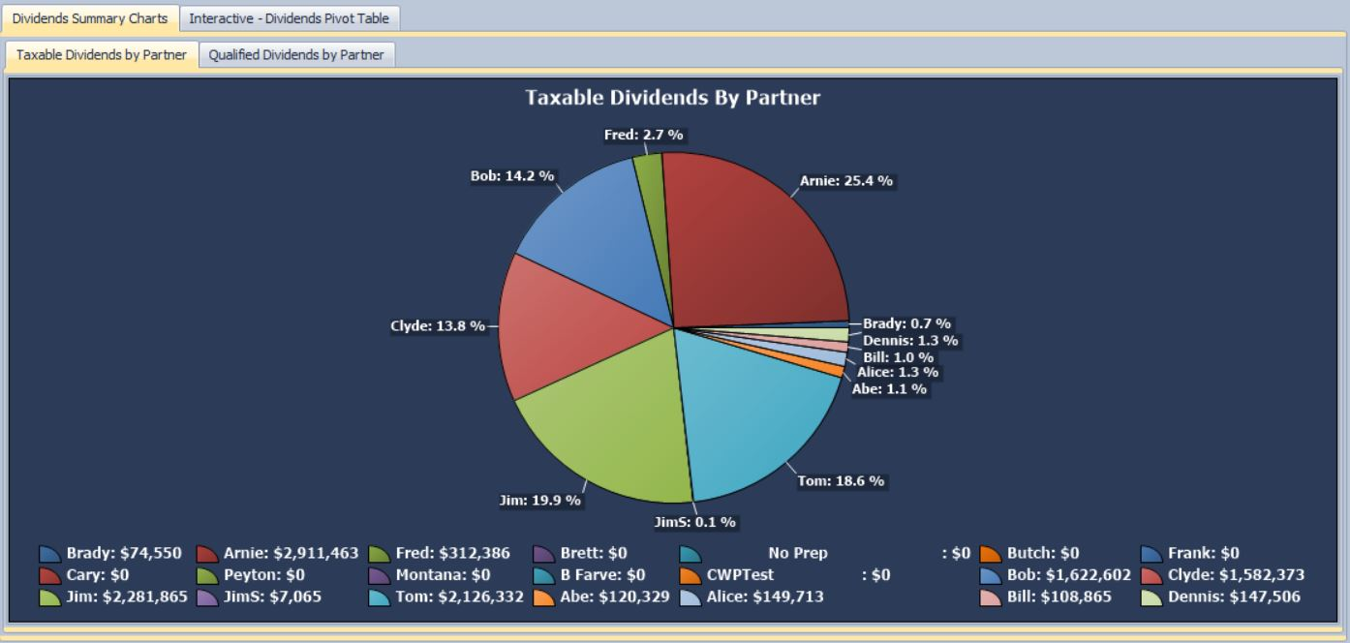

Slide 4
